Slide 1
Probablilstic Context Free Grammar

Slide 2


USE OF PCFG

Slide 3
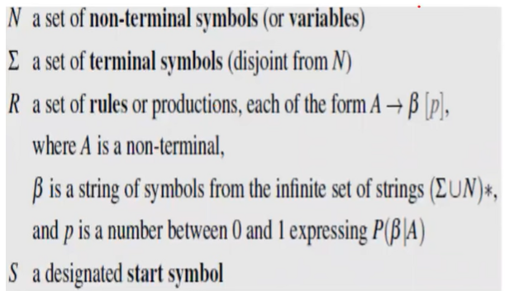
Probabilistic CFG

Slide 4



Slide 5
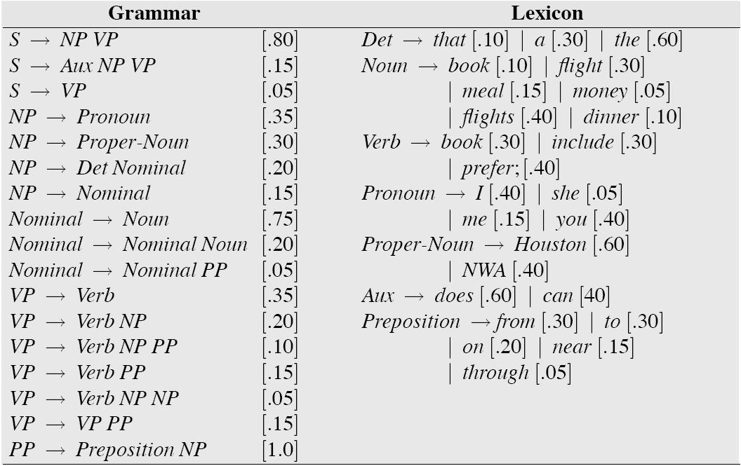

Slide 6
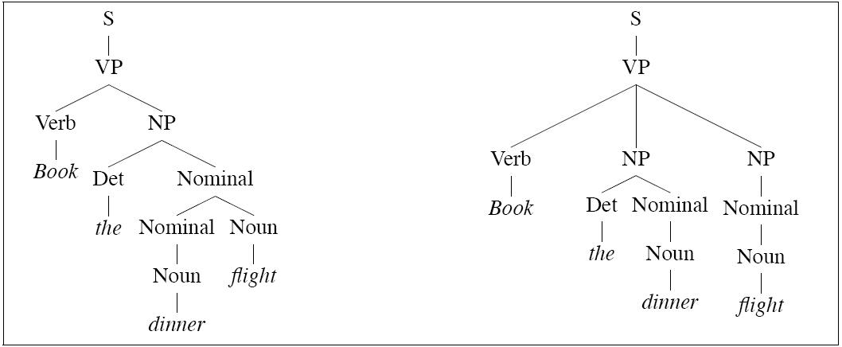
Parse Tree

Slide 7
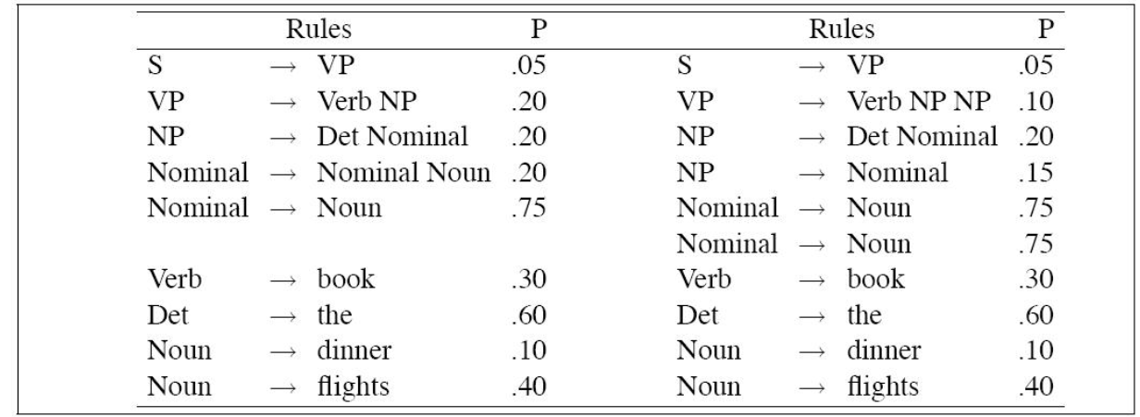
Probabilities of The above Tree

Slide 8


